Slide 1
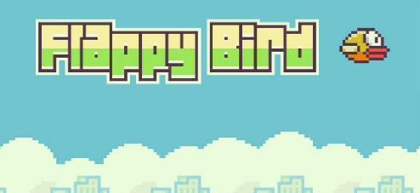
Flappy Bird
By: Jared, Ryan, David, Nick

Slide 2
Why we made Flappy Bird?
We wanted to make a graphical game in python that was something fun and simple.
We opted to use the pygame library, because we had to use python
We found the sprites (images for the game) at: www.spriters-resource.com

Slide 3
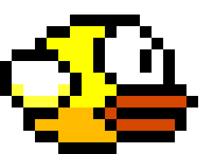
What Everyone Contributed
Ryan - game mechanics.
David - scrolling background and game design.
Jared - powerpoint and game logic.
Nick - game mechanics and math.

Slide 4
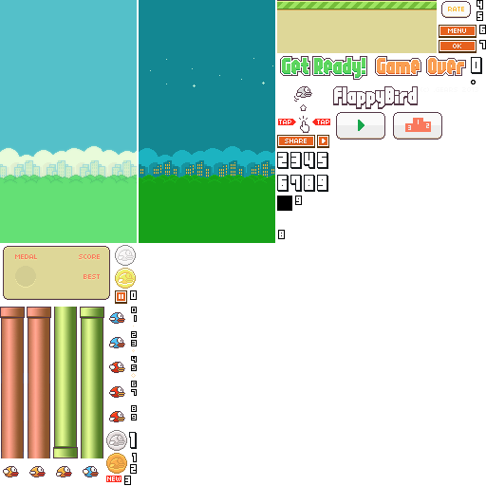
The Sprites

Slide 5
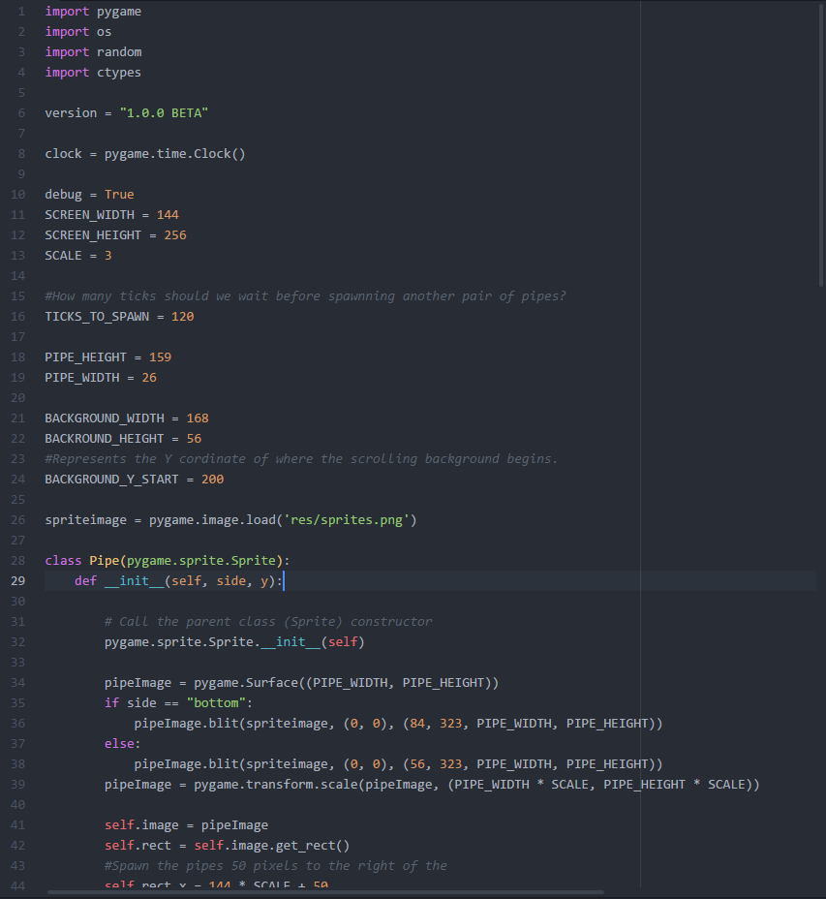
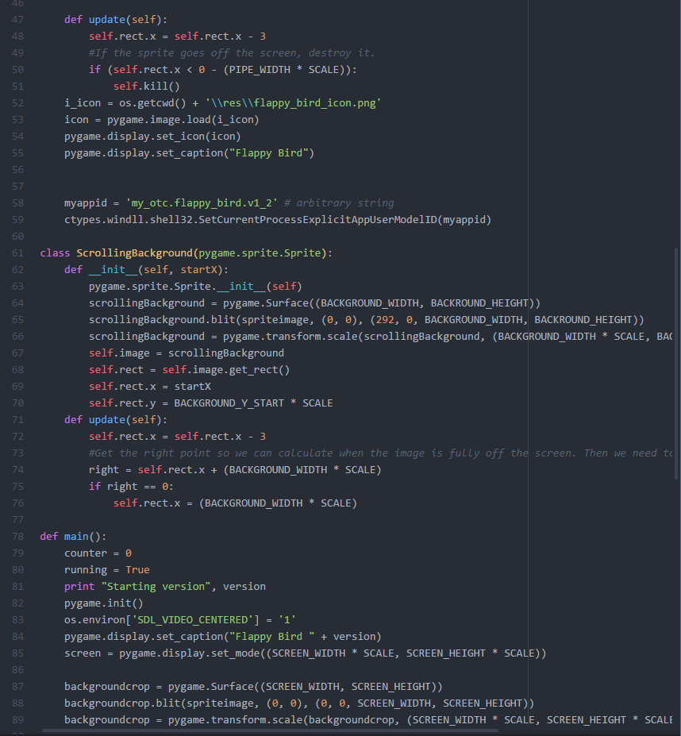
How We Did It

Slide 6
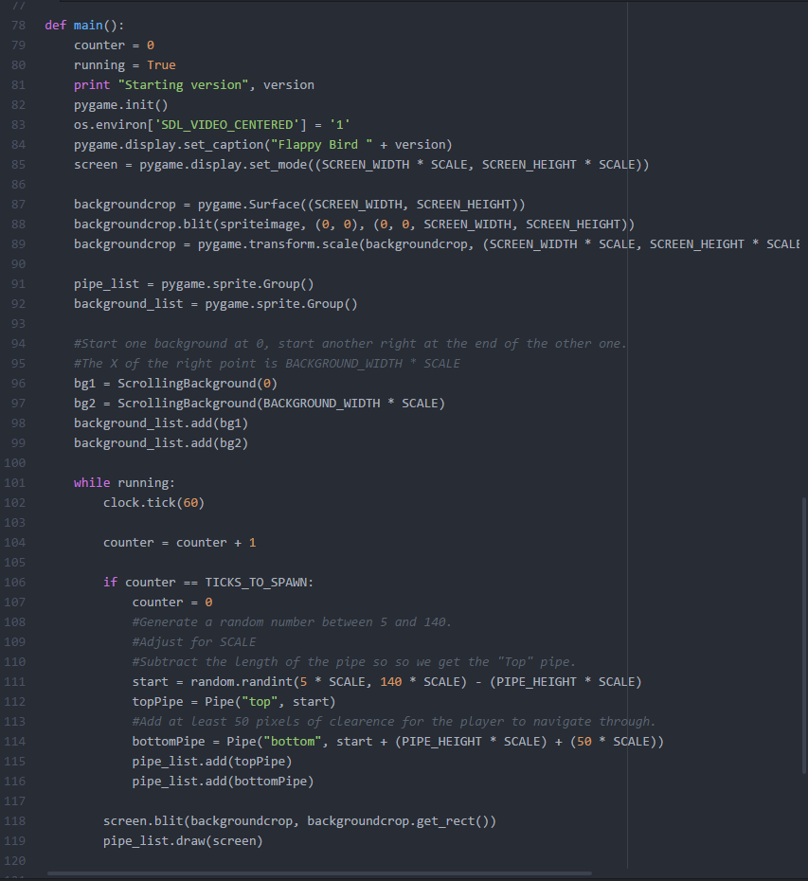
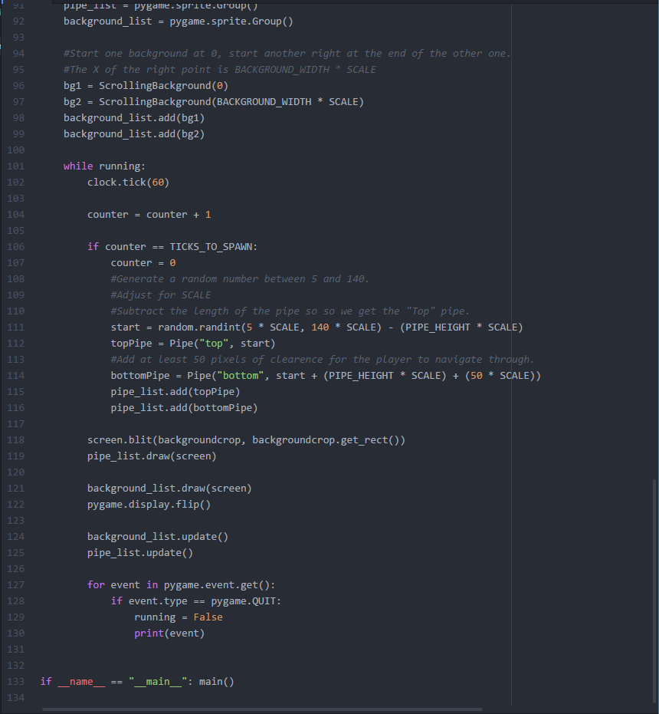

Slide 7
Demonstration

Slide 8

Where you can find it
https://github.com/Space-Narwals/FlappyBird

